Slide 1
The Team Formerly Known As: FPL
T506: Material Handling Robot
Team: Taylor Harvey, Diandra Reyes, Peter Watson, Alexander Wozny

Slide 2




ME Senior Design Team 506
Diandra Reyes
Mechatronics Engineer
ALEXANDER WOZNY
Systems Engineer
PETER WATSON
Materials Engineer
TAYLOR HARVEY
Mechanical Design Engineer
Notes:
Each member present themselves on this slide

Slide 3


Senior Design ECE Team
WALTER CALDWELL
Project Manager
TIFFANY MILLER
Hardware Engineer
SEBASTIAN MURIEL
System Engineer
ALEX JEN
Software Engineer
TONY ZHENG
Financial Advisor

Slide 4
Objective
The objective of this project is to create a partially autonomous material handling robot that works in a dark warehouse with conditions unfavorable to human workers.

Slide 5
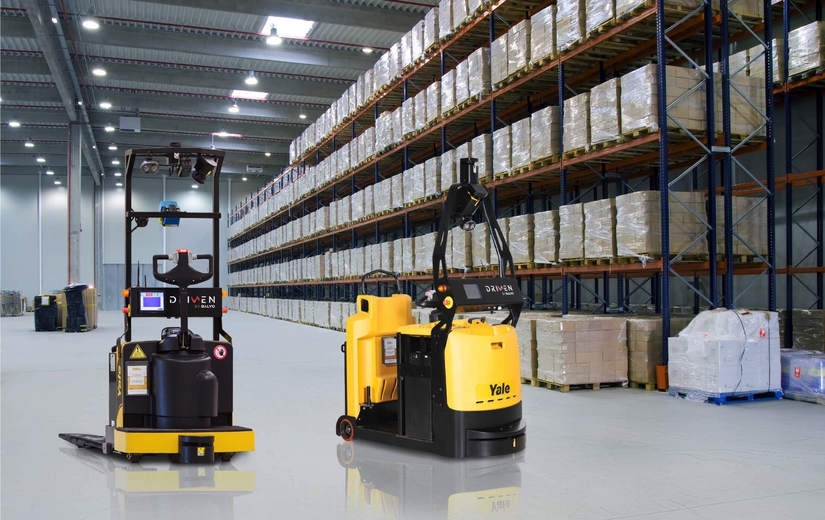
Dark Warehouses
Semi-Autonomous warehouse where robots do most of the labor
Humans provide managerial role over robots
Reduce costs and increase profits
No lights or AC needed
Robots can work 24 hours a day
Less staff needed to manage the warehouse
'Warehouse of the future'

Slide 6
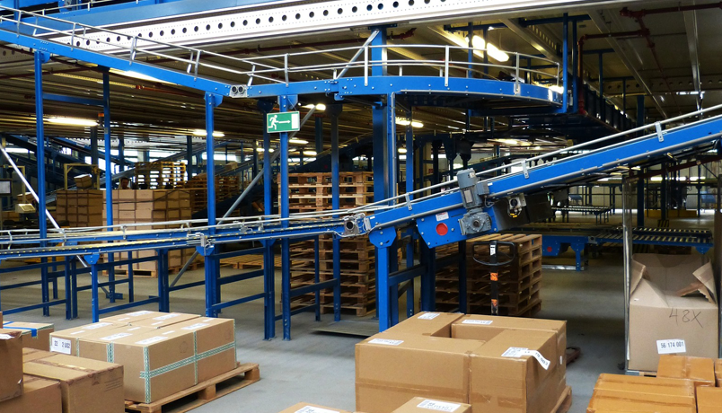
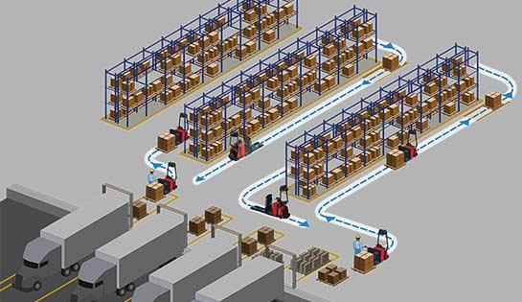
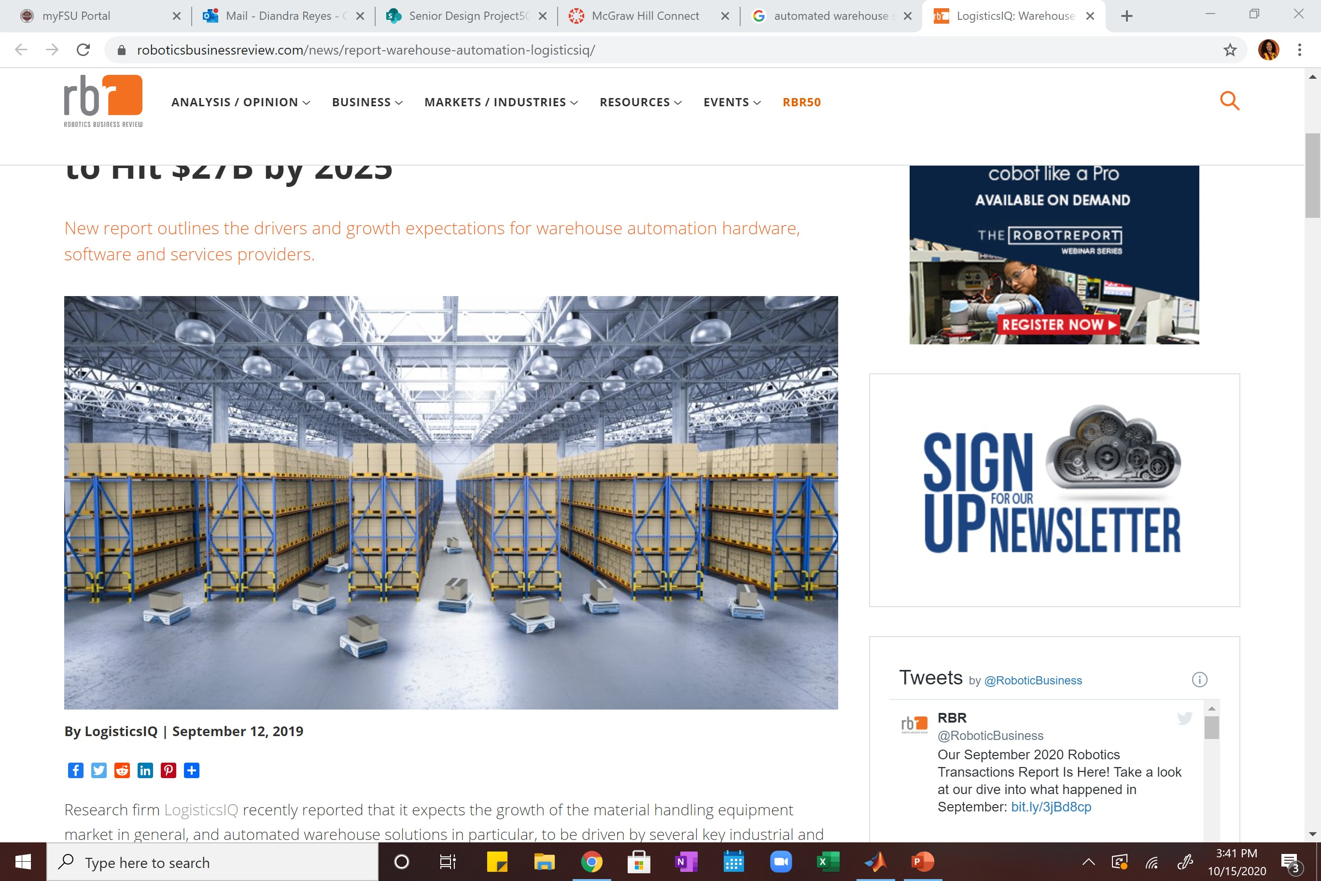
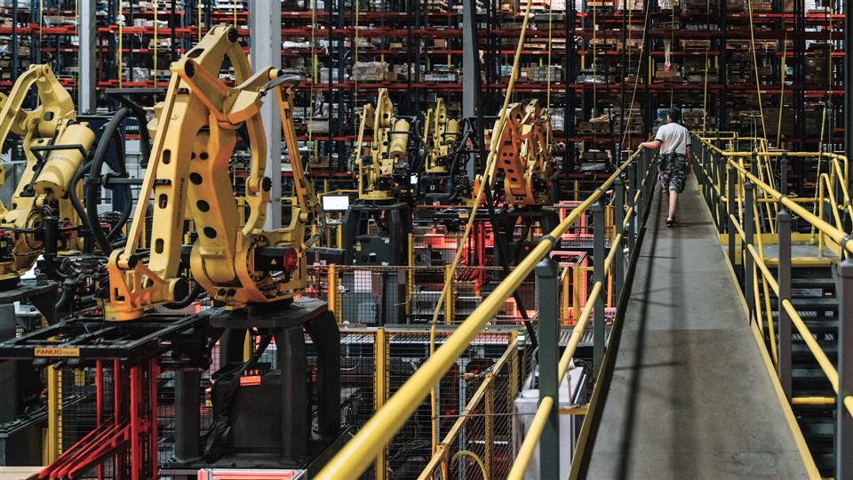
Background Information
Sorting conveyor belts
Self- navigating forklifts
Automated Warehouses
Automated ground vehicles
Material handling robotic arm
Notes:
From this slide we can show that there are different levels of autonomy that can be used for our robot.
These are merely examples
To understand the concept of this project it is important to understand the rising use of dark warehouses
Dark warehouses are considered the “warehouses of the future” specifically b/c of the technological components that make up a dark warehouse
Increase in automation and robotics to complete tasks, retrieve products, and properly store them as well as increase performance, and speed in sorting system.
Different types of automated systems implicated in dark warehouses: robotic arms assembling, conveyor belts sorting, forklifts self navigated and AGV retrieving and moving product
Most if not all these systems are controlled through an interface that connect the machinery to the supply chain
Though many companies may view warehouse automation as an “all or nothing” investment due to the desire of being completely automated, there are many benefits to implicated automated steps into the supply chain process.
The warehouse automation industry is projected to double in revenue from $13 billion in 2018 to a possible $27 billion in 2025. It is a growing market with many companies seeing the long-term benefits of switching to automated operation

Slide 7



Motivation
Cost
Efficiency
Reduces Cost for Utilities
Machines do not need central air units
Operation can happen with less lighting
Reduces Need for Manpower
Safety
Less harsh environmental conditions for human workers
Increase in Operational Time
Robots can work overnight and on weekends
Notes:
The pros of the project, why it is necessary, why it works better
-reduce cost (no need for 24/7 insulation/lighting b/c robots don’t need that, cut cost on electricity and employment; for manpower: you’d only need the folks taking care of the machines, handling errors, and folks in charge of supply chain management, everybody that was stocking by hand can go)
-increase efficiency (machine would be able to perform inventory tracking, giving user real-time data of supply chain performance); also the robots would be less likely to make a mistake on a job that humans find boring and tedious and generally make mistakes on.
Humans have a lot of needs as workers in a warehouse. The conditions in a warehouse can often reach extreme temperatures, and require constant lighting. By introducing a dark robot to a warehouse, it will reduce costs of temperature control and lighting expenses.
-

Slide 8

Project Scope
Notes:
Robot movement is partially autonomous, and partially under human control
Safely lift and move up to a 50lb load
Track inventory
Avoid obstacles and maneuver itself without collision

Slide 9
Notes:
Overall NEEDS NOTES
Customer Needs: customer wants robot to…
- Operate in a dark environment
- retrieve and deliver things in a warehouse setting (mobility)
Do the same work a human worker would; specified 50 lbs because according to OSHA [Occupational Safety and Health Administration] human workers should have to carry more than 50 lbs (Standard Performance)
Handle items without damaging them (Liability)
Behave autonomous in nature but maintain some sense of control by having a input device (Control)
Connect to supply chain network so personnel can control robots (User Interface)
find charging station and recharge independently (rechargeable)

Slide 10
Notes:
The robot will be able to support a load of 50 pounds

Slide 11





Assumptions
Maintenance will be provided by a third party
Traverses flat surfaces
The warehouse will not be altered.
A power supply is accessible.
The product is working indoors.
Notes:
Though maintenance is not included, users could access components of the robots for maintenance.
Will not provide regular services or maintenance for the robot. This is outside of the scope of our project.
Robot will only traverse over flat surfaces and no rugged terrain
The Mechanical engineering side of the group will be responsible for the package manipulation, whereas the Electrical engineering group will focus on navigation and movement of the robot

Slide 12



Notes:
Locomotion:
Locomotion is a main function and involves physically moving the robot since it needs to traverse around the warehouse effectively. One of the assumptions that made this is easier is that the warehouse ground is relatively flat and smooth, which is generally what a warehouse floor is like anyways. For successful locomotion, the robot would need to be able to move and keep the chassis stable. To move, the robot would need to be able to translate and rotate, which involves the robot moving backwards and forwards, as well as turning, and thus torque and control over the amount and direction of torque needs to be produced. We also included chassis stability because if it were unstable, it would not be able to move properly and would most likely fail in the future.

Slide 13


Notes:
Navigation:
Navigation was also included as a main function.
- This includes the robot being able to scan and track the inventory. This is involved in navigation since the robot needs to be able to know where the inventory needs to be brought to
- Navigation also includes the robot being able and knowing how to get from one location to another. If it picks up a package in one location, it needs to be able to (1) recognize its location, (2) know where the "home" of the selected inventory is, and (3)it needs to be able to figure out the path it needs to take to get to the desired location. Additionally, another important part of the robot's localization is knowing where it is relative to its surroundings. For example, if it is traveling between shelves it should be moving relatively straight and in the center of the aisles so it does not collide with the shelves or bump into the packages on the shelves. For example, if there is an obstacle in front of it, it needs to be able to recognize that it cannot move past the obstacle and that it must stop before hitting this obstacle.

Slide 14

Notes:
Once the robot is positioned correctly, it could begin navigating while manipulating the product.
Possible Idea for displaying function decomposition: Part 1

Slide 15
Notes:
Manipulation:
This primary function is essential as it accounts for the security of the materials handled by the robot. The robot’s manipulation encompass the grasping, passing, carrying, and sorting sub-functions desired by the customer. Manipulation includes the physical interactions between the robot and its environment so properties including generating friction, remaining leveled and preventing tipping or package translation.
Possible Idea for displaying function decomposition: Part 1

Slide 16
CRITICAL TARGETS AND METRICS
Change Heading Angle
Applies Even Torque
Moves Package Onto Robot
Maintain Heading Angle (Relative to Path)
Target: 360 degrees
Robot can turn any direction
Target: less than 1% of error
System evenly distributes torque on both sides of the wheels so robot can move straight
Target: 224 Newtons (50 lbs)
Robot can lift package at maximum standard weight
Target: 0 degrees
Robot accurately follows path
Locate Inventory
Target: 1 (Boolean)
Robot can retrieve/take inventory to desiredlocation
Connect Wirelessly
Target: 1 (Boolean)
System can connect to the internet and Supply Chain managing interface wirelessly
Scans Inventory
Target: 1 (Boolean)
Robot can scan a label and identify inventory
CHANGE HEADING ANGLE | APPLIES EVEN TORQUE | MOVES PACKAGE ONTO ROBOT | HEADING ANGLE MAINTAINED (RELATIVE TO PATH) | LOCATE INVENTORY | CONNECT WIRELESSLY | SCANS INVENTORY
360 DEGREES | LESS THAN 1% OF ERROR | 224 NEWTONS/ 50 LBS. | 0 DEGREES | 1 (BOOLEAN) | 1 (BOOLEAN) | 1(BOOLEAN)
Robot can turn any direction | System evenly distributes torque on both sides of the wheels so robot can move straight | Robot can lift package at maximum standard weight | Robot accurately follows path | Robot can retrieve/take inventory to desired location | System can connect to the internet and Supply Chain managing interface wirelessly | Robot can scan a label and identify inventory
Notes:
*Reorganize info so its neater
For the targets with Boolean metrics remember boolean is a conventional form of logic used to indentify whether a system (aka our robot) is or isn't performing a specified task (T:1/F:0 statements type ish)

Slide 17

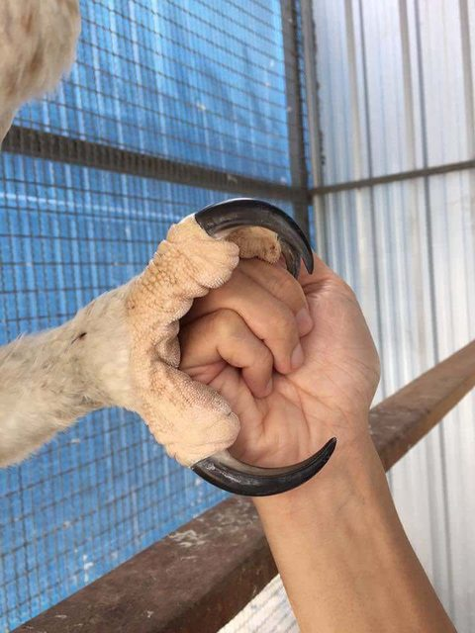


Concept Generation
Morphological Chart
Biomimicry
Battle of Perspectives
Anti-Problems
Brainstorming
Notes:
These are the five methods of concept generation we used
Morphological chart: created a chart with different suggestions for various components our robot would need such as its driving system, tracking, scanning, and manipulation. Concepts were derived by choosing one suggestion per component.
Biomimicry: we sought inspiration from nature especially animals. One idea we favored was mocking the talons of an eagle as a potential design for the robots end- effector (photo shows eagle talon wrapped around a human hand; we thought a claw-like end effector would not be as useful considering the load of the system)
Battle of perspectives: team split up into two sides to argue/defend a position regarding situational issues such as Old vs young managers using this robot (helped us infer that the robot must have an understandable interface even for those that are not tech-savy) or the robot picking up individual packages versus large loads of packages (helped us decide that the robot should manipulate whole pallets rather than packages to make our lives easier/solution less complex)
Anti-problems: here we worked backwards by thinking of potential conflicts the robot can have and producing the necessary solution for those conflicts that way the solution is accounted for before prototyping begins; ie. Robot purposely hides from user, solution: incorporate GPS system as well as user control settings so robot is not always autonomous.
Brainstorming: last resort to come up with a bunch of ideas; we all just sat down as a team and made up a bunch of concepts

Slide 18
Significant Components
Scan Inventory
Control Package
Obstacle Detection
Path Following
Drive Train
Notes:
Following slides will provide most applicable options for each component

Slide 19
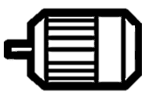
Scan Inventory
Differential Steering
Omni-directional Wheels
Control Package
V₁
V₄
V₁
V₄
Obstacle Detection
V₂
V₃
TURN LEFT
V₂
V₃
FORWARD
V₄ = V₂
V₃ = V₁
Front Wheel Control
Rear Wheel Control
Path Following
Drive Train
Notes:
Differential steering: to turn left right wheels are applied a higher torque (rotate faster) to cause the robot to turn left
Omnidirectional wheels: for the second figure it is showing each velocity going different directions however V1 = V3 and if they are greater than V4 = V2 then the robot should turn right.
(rear) This has to do with being able to steer by changing the orientation of the wheels. Rear wheel drive
(front) Same as right above. Front wheel drive.

Slide 20



Scan Inventory
Heated Line
Control Package
Magnetic Tape
GPS
Obstacle Detection
Induction Wire
Path Following
Drive Train
Pavement Markings
Notes:
Magnetic Tape
Line Path
GPS
Heated Line
Pavement Markers
Induction Wire

Slide 21
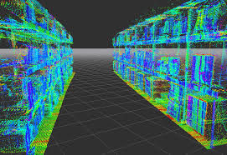

Scan Inventory
Lidar
Ultrasonic Sensors
Control Package
Obstacle Detection
Infrared Sensors
Push Sensor with Bumper
Path Following
Drive Train
Notes:
Lidar: 3D reconstruction of warehouse with LiDAR localization applications applied to it
Ultrasonic: blue are waves emitted from sensor on robot to nearby objects, red are potential waves being bounced back from nearby objects. Distance is calculated from how fast the wave bounces back
Infrared: transmit an infrared signal, this infrared signal bounces from the surface of an object and the signal is received at the infrared receiver
five basic elements used in a typical infrared detection system: an infrared source, a transmission medium, optical component, infrared detectors or receivers and signal processing
Planck’s law states that “every object emits radiation at a temperature not equal to 0⁰K”. Stephen – Boltzmann law states that “at all wavelengths, the total energy emitted by a black body is proportional to the fourth power of the absolute temperature”. According to Wien’s Displacement law, “the radiation curve of a black body for different temperatures will reach its peak at a wavelength inversely proportional to the temperature”.
https://www.electronicshub.org/ir-sensor/
Push sensor with bumper: instantly notifies the robot when the force switch detects even the lightest of touch

Slide 22
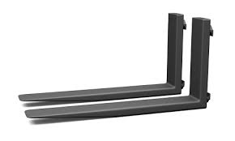




Scan Inventory
Forks
Vacuum End Effector
Control Package
Single Clamp/Claw
Obstacle Detection
Hook
Magnetic End Effector
Path Following
Drive Train

Slide 23




Scan Inventory
QR Code
RFID Tag
Barcode Scanner
Control Package
Obstacle Detection
April Tag
Color Coded
Path Following
Drive Train

Slide 24
Medium Fidelity’s

Slide 25

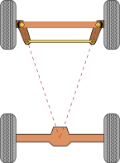
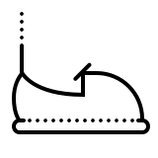

”Bump Shock"
"Captain Hook"
Scan Inventory
Wheel Orientation Control
Obstacle Detection
Bumper with
touch sensor
Induction Wire
Hook
Barcode
Line path
April Tag
Path Following
Drive Train
Control Package

Slide 26

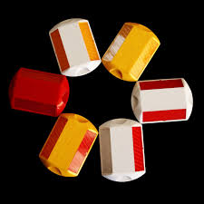

“Laser Clamper”
”Bump Shock"
Scan Inventory
Wheel Orientation Control
Wheel Orientation Control
Obstacle Detection
Bumper with
touch sensor
Pavement
markers
Clamp
QR code
Induction Wire
Hook
April tag
Lidar
Path Following
Drive Train
Control Package

Slide 27
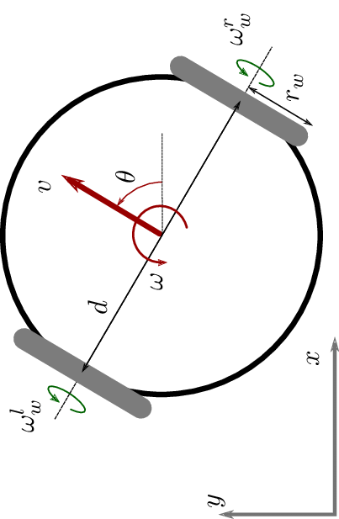
”Differential Clamp”
“Laser Clamper”
Scan Inventory
Wheel Orientation Control
Differential
Drive
Obstacle Detection
April Tag
Pavement
markers
Clamp
QR code
Lidar
Clamp
Path Following
Drive Train
Control Package

Slide 28




“Ultra Magnetic Forklift”
“Differential Clamp”
Scan Inventory
Differential
Drive
Magnetic Tape
Obstacle Detection
Pavement
markers
Clamp
April Tag
Forks
RFID
Ultrasonic
Lidar
Path Following
Drive Train
Control Package

Slide 29
High Fidelity’s

Slide 30
“Differential Forklift”
“Ultra Magnetic Forklift”
Scan Inventory
Differential
Drive
Obstacle Detection
QR Code
Magnetic Tape
Forks
RFID
Ultrasonic
Line Path
Path Following
Drive Train
Control Package
Notes:
Differential drive, lithium ion battery powered, line path following with infrared, forks, ultrasonic obstacle detection, QR code

Slide 31
“Omni Forklift”
“Differential Forklift
Scan Inventory
Differential
Drive
Omni-Directional
Obstacle Detection
QR Code
Ultrasonic
Line Path
Forks
Path Following
Drive Train
Control Package
Notes:
Omni-directional Wheels
Lithium ion battery
Line path for navigation
Forks for manipulation
Ultrasonic obstacle detection
infrared (line path)
Scans Inventory using QR code

Slide 32
“Vacuuminator”
“Omni Forklift
Scan Inventory
Magnetic Tape
Omni-Directional
Vacuum End-Defector
Obstacle Detection
QR Code
Line Path
Forks
RFID
Lidar
Ultrasonic
Path Following
Drive Train
Control Package
Notes:
Omni-directional Wheels
lithium polymer battery
Magnetic tape for navigation
Vacuum end effector for manipulation
RFID
Lidar

Slide 33
Locomotion Control
Heading Angle
Robot Velocity
Wheel Torque
Notes:
When figuring out which concepts best served the customer needs. The factors or engineering characteristics we found to be important were taken into consideration when reviewing each of the design concepts. For example wheel torque, robot velocity and heading angle were factors that were taken into consideration. Controlling the locomotion aspect of the robot requires controlling the wheel torque, which in turn affects the robot velocity and heading angle. The different types of wheels and drive configurations play a part in these. Although more motors with torque might be more difficult to control, such as with the omni-wheels, more wheel torque allows the robot to have the potential to move faster.

Slide 34
Locomotion Control
Heading Angle
Robot Velocity
Wheel Torque

Slide 35

Locomotion Control
$$φ$$
Heading Angle
Robot Velocity
Wheel Torque
Notes:
Additionally, it is important that we are able to control the heading of the angle of the robot and make sure that it stays on the right path.

Slide 36
Path Finding
Notes:
Magnetic tape is expensive along with the sensor. Induction wire uses electricity which costs money. So would the heated wire. The infrared line sensing was something that we were leaning towards since it is simple and unlike the pavement markers, is easier to center the robot on. Also it is inexpensive and easy to access. Pavement markers also leave more room for error since separate lines are being laid down.

Slide 37

Lift Force

Slide 38
Lift Force
Notes:
A claw or end-defector or design like this would be useful as it would allow for more flexibility in placing the box down. This method is one of the more complicated ones, since varying levels of degrees of freedom would have to be controlled. This was evident in just designing this animation, for example.

Slide 39

Lift Force
Notes:
However, since the claw is in contact with the box, it might squeeze the box to tight in order to hold it, or it may not have enough upward force/friction to keep the box up, causing it to drop and hurt the package and its contents.

Slide 40
Lift Force
Notes:
Vacuum end defector is not reasonable since it would have trouble lifting heavy loads and heavy objects will fall and be damaged. Additionally, this would require a lot more power consumption than the other options.

Slide 41
Object Detection
Notes:
Lidar is expensive
Push sensors were something that we were not big on since we didn’t want our robot to crash into anything. We want it to notice and object and come to a stop before hitting it. Hitting it could hurt the robot or the package, or in the case of a person being in the warehouse (which we are trying to eliminate), it could injure the person.

Slide 42
Scanning
Notes:
RFID tags were considered since the robot can scan them from anywhere. However, we found that one problem with this was that this made it harder to key in on a specific object. They are typically used for scanning a lot of items. Another thing was the RFID scanner is expensive, too.

Slide 43
Scanning
Notes:
RFID tags were considered since the robot can scan them from anywhere. However, we found that one problem with this was that this made it harder to key in on a specific object. They are typically used for scanning a lot of items and can be scanned from anywhere within a certain distance threshold. Another thing was the RFID scanner is expensive, too.

Slide 44
Scanning
Notes:
QR codes hold a good amount of information. Additionally, they can be scanned at different angles, allowing for more flexibility. Holds 7000 numbers—or 4000 alphanumeric characters. Doesn't require an expensive scanner

Slide 45
Scanning
Notes:
April tags don't hold as much information as QR codes --> Small amount of data (4 to 12 bits)
Allows for flexibility since they don't have to be scanned from head on.

Slide 46
Scanning
Notes:
Not as flexible since the scanner has to be lined up well with the barcodes. Holds up to 20 characters.

Slide 47
Precision
Notes:
If the robot goes to deliver or retrieve a package, it might have more difficulty lining up as it has to move a lot to realign itself. This could be for reasons like the wheels slipping and the robot not noticing. The robot might have to try to correct itself several times.

Slide 48
Precision
Notes:
With the omni-direction wheels however, if the robot ends up too far to the left or right, it is able to just move sideways. It doesn’t have to spend time backing up. It is able to line itself up easier. Note that a forklift setup is used in this example. However, if the lifting mechanism had more freedom, such as if it were an end-effector type mechanism. This would make up for the precision a bit.

Slide 49
Final Selected Design Concept

Slide 50
Autonomous Robots
at work

Slide 51
Autonomous Robots
at work

Slide 52
Autonomous Robots
at work

Slide 53

Autonomous Robots
at work

Slide 54
Autonomous Robots
at work

Slide 55
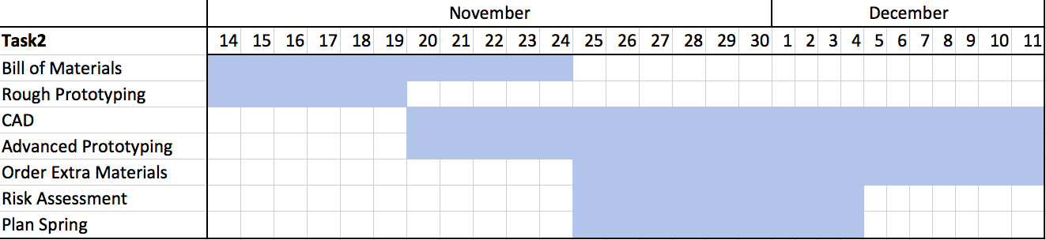
End of Semester Timeline

Slide 56




Taylor Harvey
Diandra Reyes
Phone: 321-201-8727
Email: tah16c@my.fsu.edu
Phone: 786-333-9946
Email: dreyesb97@gmail.com
Alexander Wozny
Peter Watson
Phone: 727-600-6472
Email: phw17@my.fsu.edu
Phone: 480-599-9937
Email: alexanderwozny24@gmail.com

Slide 59
Notes:
Locomotion:
Locomotion is a main function and involves physically moving the robot since it needs to traverse around the warehouse effectively. One of the assumptions that made this is easier is that the warehouse ground is relatively flat and smooth, which is generally what a warehouse floor is like anyways. For successful locomotion, the robot would need to be able to move and keep the chassis stable. To move, the robot would need to be able to translate and rotate, which involves the robot moving backwards and forwards, as well as turning, and thus torque and control over the amount and direction of torque needs to be produced. We also included chassis stability because if it were unstable, it would not be able to move properly and would most likely fail in the future.

Slide 60
Autonomous Robots
at work
Notes:
The robot will be able to support a load of 50 pounds

Slide 62


“”
“Differential Forklift”
Differential
steering
RFID
Magnetic tape
Ultrasonic
Infrared
Fork

Slide 63
Path Finding
Notes:
MAYBE ADD HEATED WIRE AS WELL

Slide 64


Slide 65
Lift Force
Notes:
Claw

Slide 66
Appendix

Slide 67
Needs Table
What is the purpose of this robot? | The robot must be able to retrieve and deliver things in a warehouse setting. -Customer | Robot is autonomous in nature and capable of data-processing.
What are the surroundings and environment the robot will be operating in? | It will be used in a warehouse setting. The robot should be able to operate in conditions that are unfavorable to humans (i.e. hot temperatures that could make workers pass out or get heat strokes). -Customer/Dr. McConomy | The robot is able to navigate around a warehouse.
 |  | The robot is able to sense and navigate around obstacles.
 |  | The robot can perform tasks in the dark.
 |  | Also, will perform in temperature conditions undesirable to humans.

Slide 68
Needs Table (continued)
What kind of items should the robot be able to handle? (Approximate weight) | Following OSHA regulations, a person should not be able to carry more than 50 lbs. If the robot were to malfunction a worker must aid it. Thus, the robot should carry a max load of 50 lbs. -OSHA | The robot can carry packages up to 50 lbs.
 |  | The robot will follow OSHA regulations.
 |  | When the robot malfunctions, it sends out an error alert for servicing.
What kind of retrieval methods should the robot achieve? | The robot should be able to pick things in a vertical and horizontal motion. Also, items shouldn’t be damaged when being set down. -Customer | Robot will have multiple degrees of freedom for movement.
 |  | Robot includes grasp force and manipulation control to prevent damaging items.

Slide 69
Needs Table (continued)
Would you want to have a handling input device? | “The robot can be operated under supervisory control. ​” -Customer | The user will operate and control the robot if desired.
What forms of power supply are accessible to you? What kind of power source do you prefer? | The robot has to have some way to recharge its battery fully so it can be active all hours of the working day. -Customer | Robot can operate over a 9-hour period before it has to recharge.
 |  | Robot navigates to an area where it can receive charging before the battery runs out.
Do you need the robot to track inventory as it delivers items? | Yes, it must be able to interface with our supply chain system | The robot will include modules to process machine readable codes and deliver information.

Slide 70
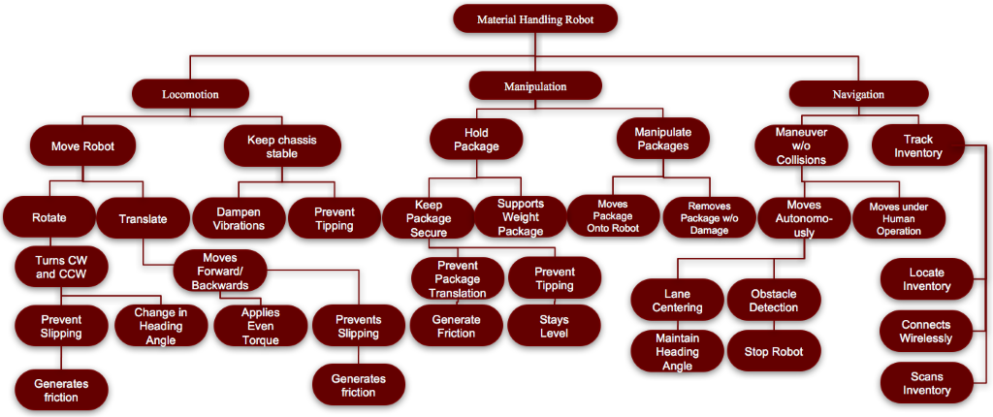
Functional Decomposition
Notes:
3 primary systems:
Locomotion – has to do with physically moving the robot
Manipulation – has to do with moving and manipulating the packages
Navigation – has to do with moving around and navigating around the warehouse
- Inventory Tracking

Slide 71
Material Robot
Locomotion
Move Robot
Keep Chassis Stable
Manipulation
Manipulate Package
Navigation
Hold Package
Track Inventory
Manuever Without Collision

Slide 72
Locomotion
Move Robot
Keep Chassis Stable
Translate
Dampen Vibration
Prevent Tipping
Rotate
Moves Forward and Backward
Turns CW and CCW
Applies even torque
Prevents slipping
Change heading angle
Prevents slipping

Slide 73
Manipulation
Manipulates Package
Moves Package onto Robot
Removes Package from Robot
Holds Package
Keeps Package Secure
Prevent Package Translation
Prevent Package Tipping
Support Package Weight

Slide 74
Navigation
Maneuver without Collision
Moves autonomously
Moves under Human Operation
Track Inventory
Connects to Network
Locates Inventory
Scans Inventory
Lane Centering
Obstacle Detection

Slide 75
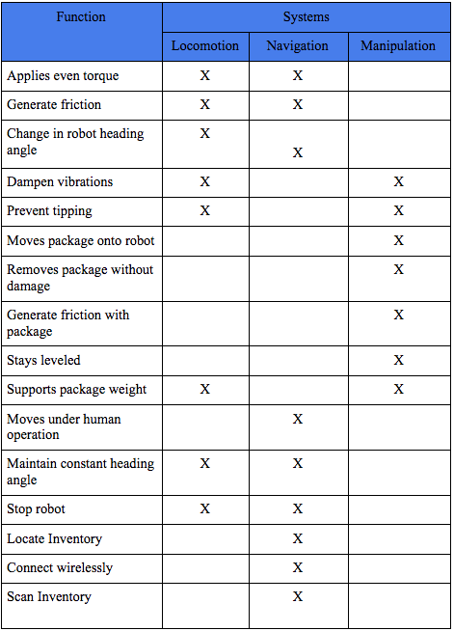

Slide 76
Targets and Metrics
Attribute | Target | Unit of Measure | Metric | Description
Generates Friction (wheels) | 17.1 N | Newtons | Force | The wheels must have enough friction to prevent slip
Change in Heading Angle | 360º | Degrees | Angle | Robot turns in a full circle.
Applies Even Torque | <1% | Percent | Error | Robot applies even torque on both sides of the wheels to move straight.
Control velocity | 2.25 m/s | Meters per second | Velocity | Minimum traveling speed through the warehouse.
Generates friction (box) | ≤ 22.68 N | Newtons | Force | The box must be prevented from sliding.
Generates friction (manipulator) | ≤ 22.68 N | Newtons | Force | The manipulator must have enough friction to prevent box from slipping
Stays level | 0º | Degrees | Angle | Robot maintains an even horizontal alignment.
Moves Package onto Robot | 224 N | Newton | Force | Robot lifts package inventory.

Slide 77
Targets and Metrics (cont.)
Attribute | Target | Unit of Measure | Metric | Description
Moves Package onto Robot | 224 N | Newton | Force | Robot lifts package inventory.
Removes Package w/o Damage | 0 | Packages | Amount | Only a certain percent of packages show signs of damage.
Maintain Heading Angle (Relative to Path) | 0º | Degrees | Direction | Robot accurately follows a path.
Stop Robot | 0 m/s | Meters per second | Velocity | Robot stays in the stopping position.
Accelerate Robot | < 1 m/s² | Meters per second squared | Acceleration | Robot must not accelerate (positively and negatively) so fast that the package falls off.
Moves Under Human Operation | 1 | N/A | Boolean | Robot responds to human input
Locate Inventory | 1 | N/A | Boolean | Robot knows where inventory belongs and takes/retrieves inventory to the correct location.
Connect Wirelessly | 1 | N/A | Boolean | Robot can successfully connect to inventory database and be controlled wirelessly.

Slide 78
Targets and Metrics (cont.)
Attribute | Target | Unit of Measure | Metric | Description
Moves Package onto Robot | 224 N | Newton | Force | Robot lifts package inventory.
Connect Wirelessly | 1 | N/A | Boolean | Robot can successfully c
Scans Inventory | 1 | N/A | Boolean | Robot is able to scan a label and identify inventory.
Senses Obstacles | 2.5 m | Meters | Distance | Robot detects obstacle in its path.
Sends Error Message | 1 | N/A | Boolean | If the robot detects an obstacle it will send an error message to the appropriate personnel.

Slide 79
Morphological Chart
 | Option 1 | Option 2 | Option 3 | Option 4 | Option 5 | Option 6 | Option 7
Drive Train | Differential Steering | Omni-Directional (Universal) | Ackerman (Rear wheel drive) | Ackerman (Front wheel drive) | Track Rails | Magnetic Track
Power | Lithium Ion | Lead Acid | Lithium Polymer | Alkaline | Nickel Cadmium
Path Following | Magnetic tape | Line path | Track “rails” | GPS | Heated line | Pavement Markers | Induction Wire
Obstacle Detection | Lidar | Thermal | Visual Inertial | Infrared | Ultrasonic | Distance sensor | Push sensor with bumper
Controls package | Forks | Vacuum end effector | Single Clamp/claw | Magnet end effector | Hook | Two Clamps/Claw
Scans Inventory | QR Code | RFID Tag | Barcode Scanner | April Tag | Color coded

Slide 80
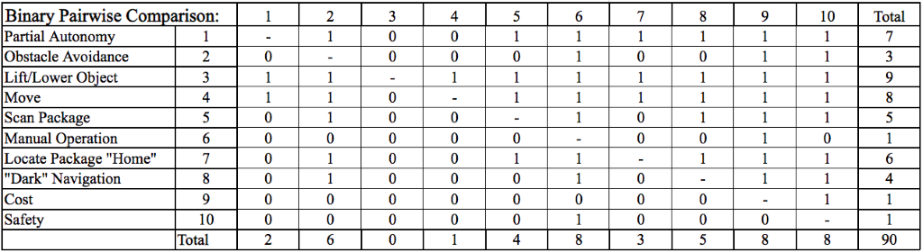
Binary Pairwise Comparison

Slide 81
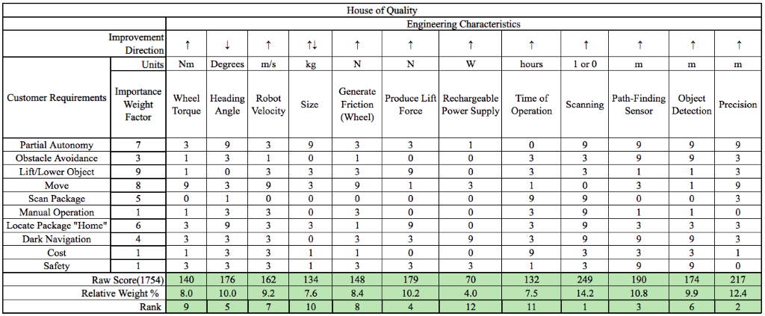
House of Quality

Slide 82
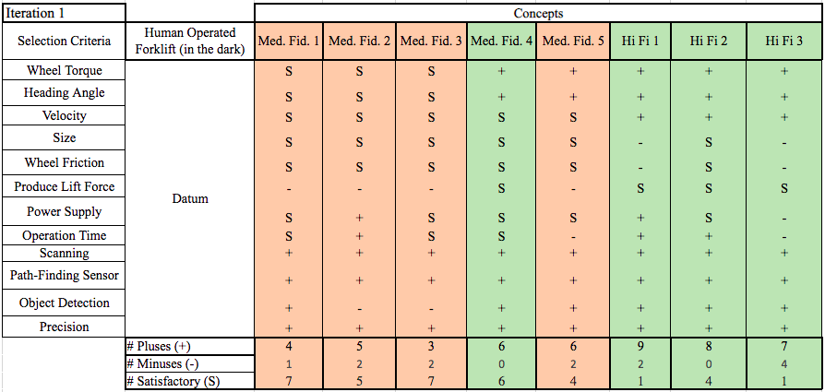
Pugh Chart Iteration 1

Slide 83
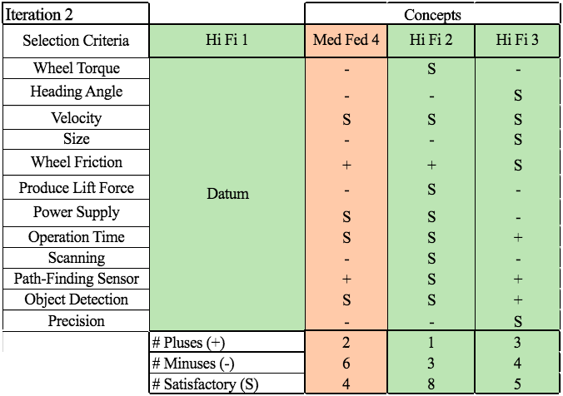
Pugh Chart Iteration 2

Slide 84
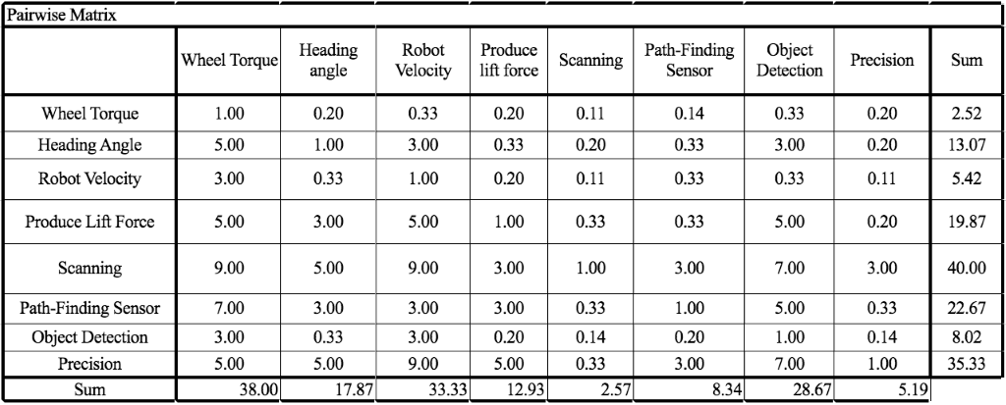
Pairwise Matrix

Slide 85
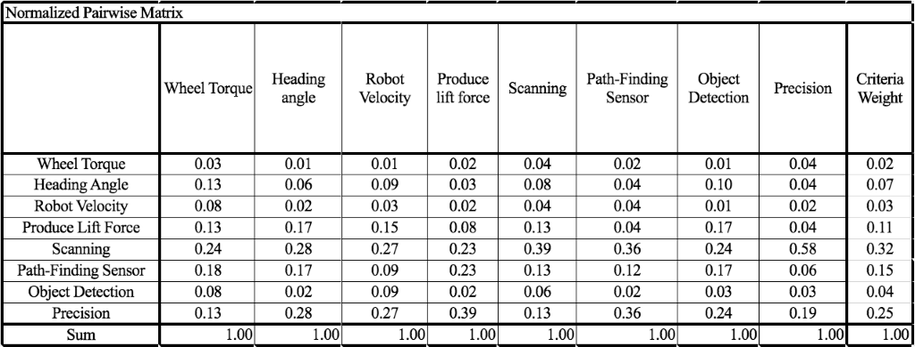
Normalized Pairwise Matrix

Slide 86
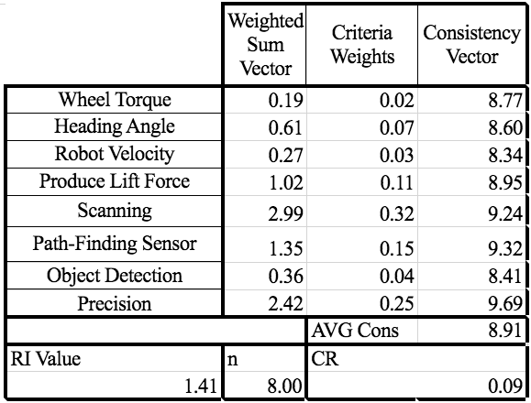
Consistency Check Engineering Characteristics

Slide 87
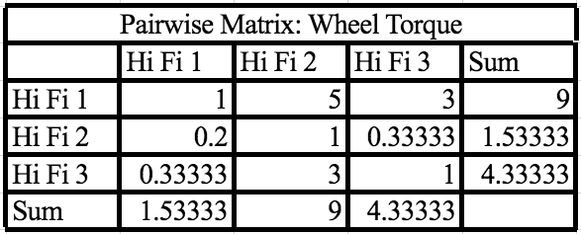
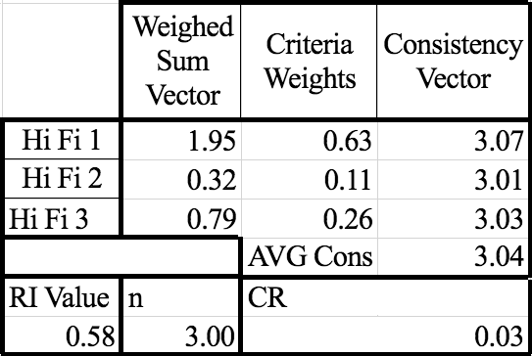
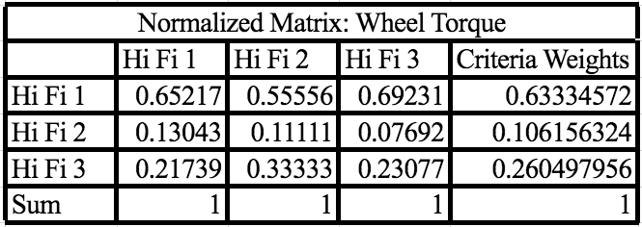
Wheel Torque Matrices

Slide 88
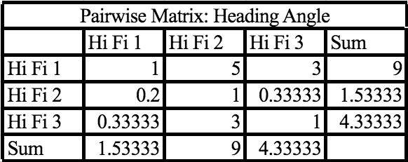
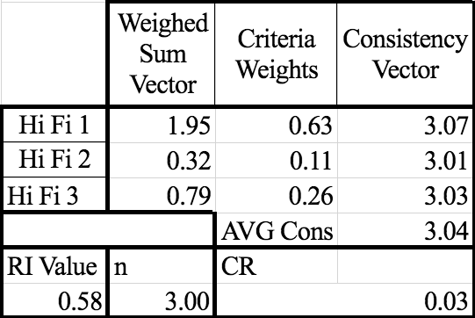
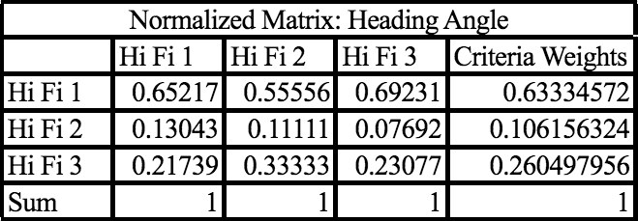
Heading Angle Matrices

Slide 89
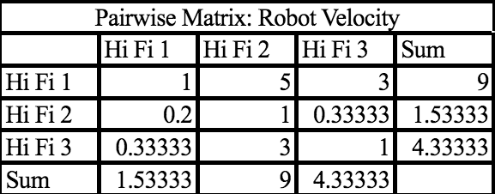
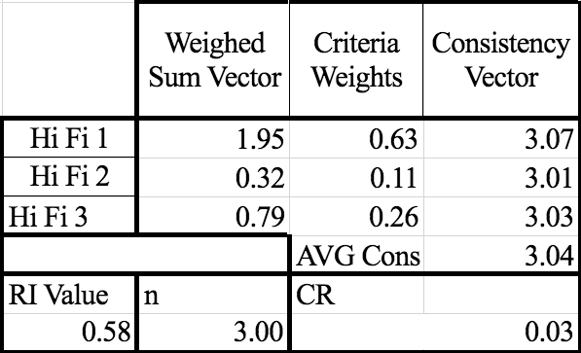
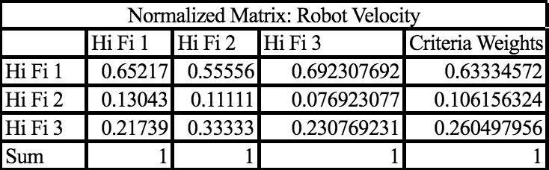
Robot Velocity Matrices

Slide 90
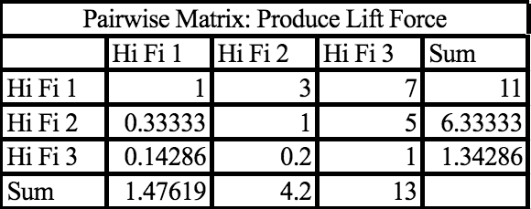
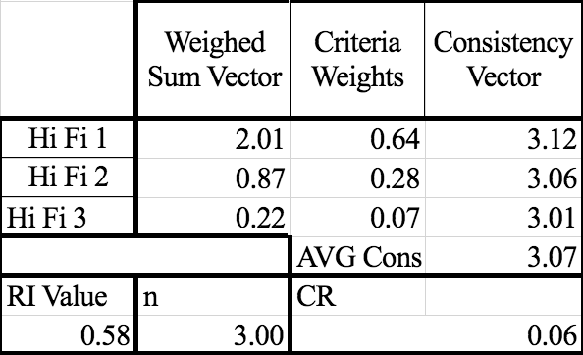
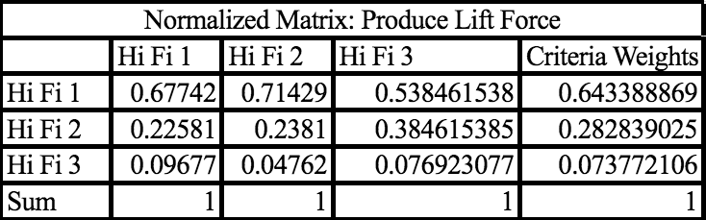
Lift Force Matrices

Slide 91
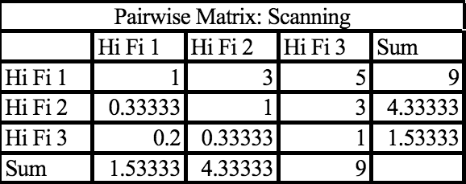
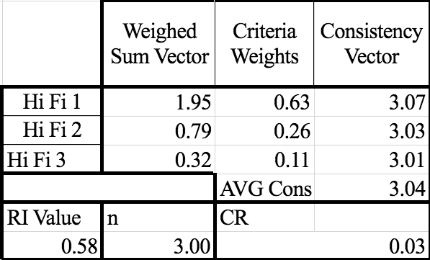
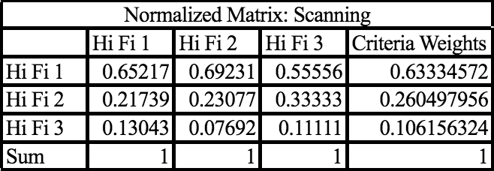
Scanning Matrices

Slide 92
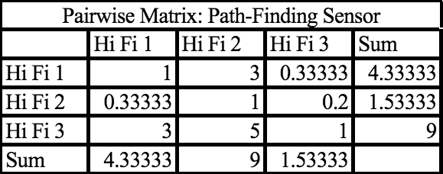
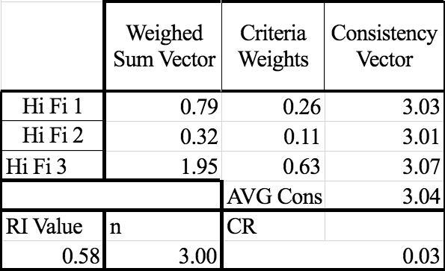
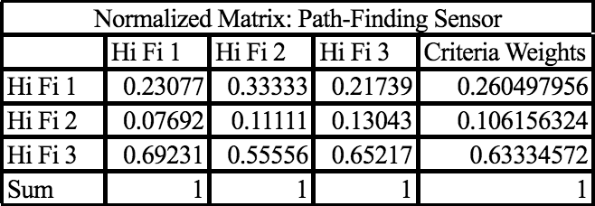
Path Finding Matrices

Slide 93
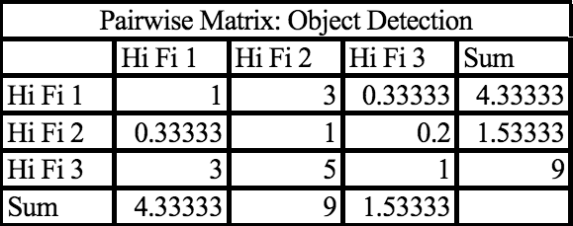
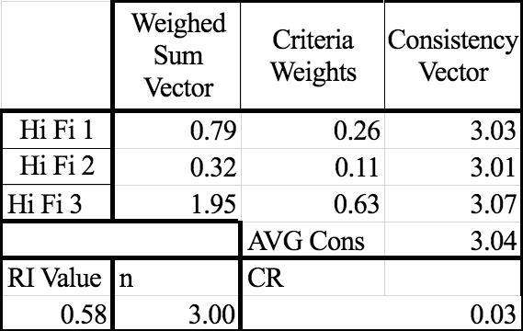
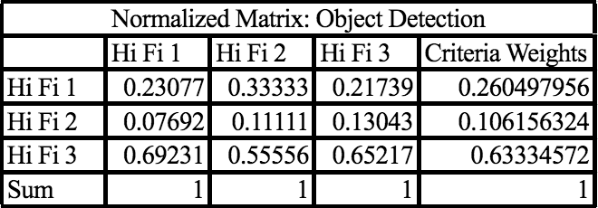
Object Detection

Slide 94
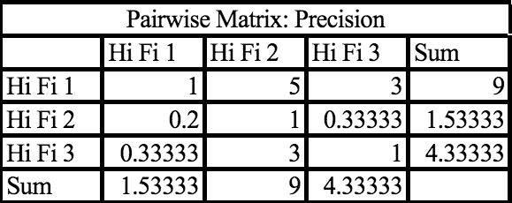
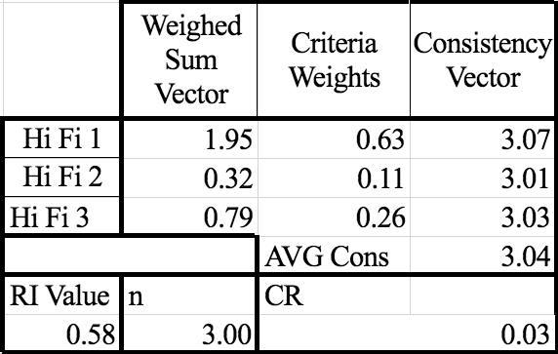
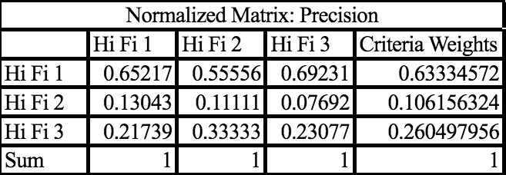
Precision

Slide 95
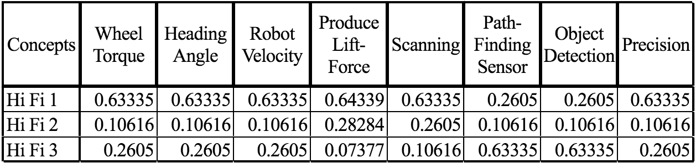
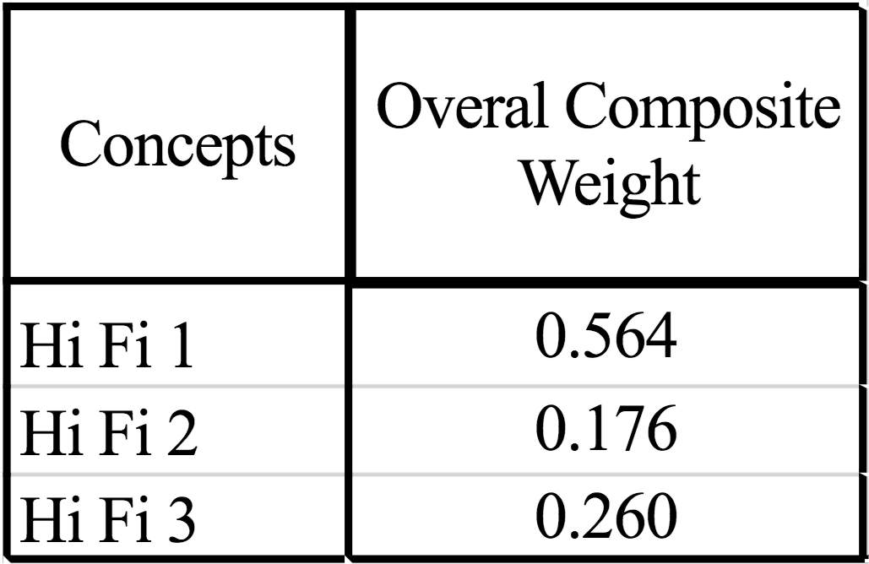
Final Selection

Slide 96
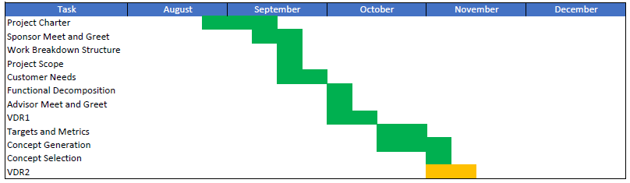
Gantt Chart
- Complete
- In Progress
- Pending

Slide 97

Spring Semester Plan

